Slide 1


Cyber Security
USTH
PEER-TO-PEER FILE SHARING SYSTEM
Network Programming
Group 2

Slide 2
INTRODUCTION
&
PROBLEM
This project builds a P2P file sharing system for local networks:
enables fast,
reliable file transfers
by discovering peers, splitting files into chunks, and downloading from multiple sources simultaneously.
It also verifies file integrity with SHA-256 and controls bandwidth to ensure smooth performance.
Goal: Build an efficient file sharing environment with file chunking and multi-source downloading

Slide 3
CONTENT
TCP Communication Between Peers
System Overview
Requirements and Development Environment
Searching Files on the Network
Multi-threaded file
download
Peer Discovery
Command Line Interface (CLI)
Local File Management

Slide 4
Cyber Security
USTH
SYSTEM
OVERVIEW
Network Programming
Group 2

Slide 5

Decentralized P2P network: peers act as both client & server
Peer discovery via UDP broadcast
File search & download over TCP
Files split into chunks for parallel downloading
Local indexing and SHA256 hashing for file integrity

Slide 6
Cyber Security
USTH
ENVIRONMENT
Network Programming
Group 2

Slide 7
OS: Ubuntu 20.04+ or any POSIX-compatible system
Compiler: GCC
Main libraries: pthread (multithreading), OpenSSL (SHA-256)

Slide 8
Cyber Security
USTH
PEER
DISCOVERY
Network Programming
Group 2

Slide 9
Purpose: Peers automatically discover each other without a central server.
How it works:
Each peer broadcasts its presence periodically using UDP broadcast.
Peers listen on the UDP port for broadcast messages and update the peer list accordingly.
Benefits:
Automatic detection of new peers in the local network.
Maintains an updated list of active peers based on the last seen timestamp.

Slide 10
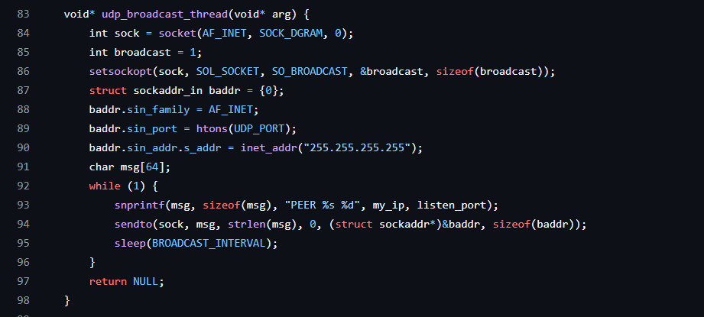
UDP BROADCAST (SENDING PRESENCE)

Slide 11
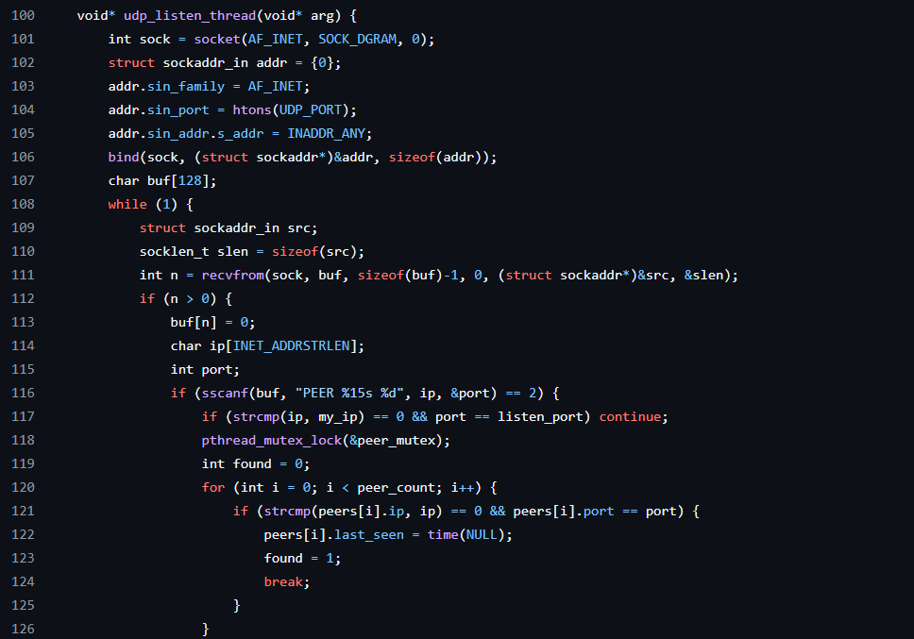
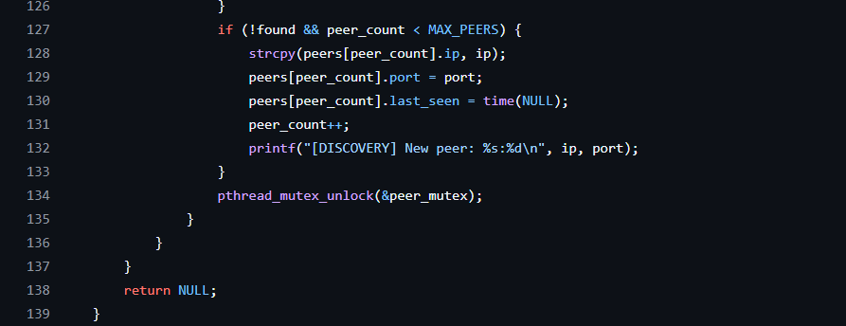
UDP LISTEN (RECEIVING PRESENCE)

Slide 12
Cyber Security
USTH
LOCAL FILE
MANAGEMENT
Network Programming
Group 2

Slide 13
Files to share are stored in the local ‘shared’ directory.
The system indexes all files in this folder at startup or when updated.
Each file is processed to:
Calculate its SHA256 hash for integrity verification.
Determine the file size and the number of chunks (fixed chunk size).
Files are split into chunks for efficient parallel downloading.

Slide 14
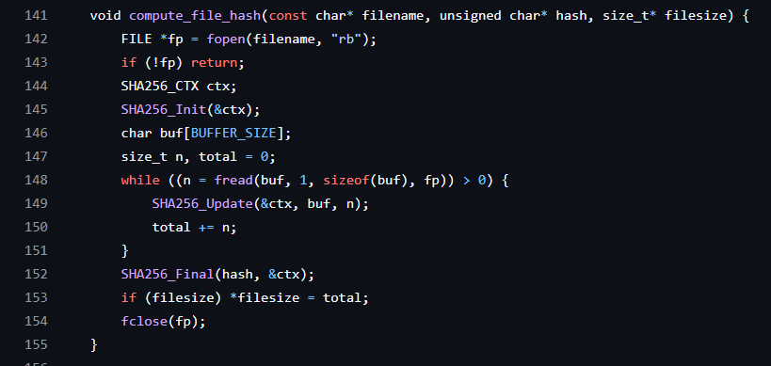
COMPUTING SHA256 HASH OF A FILE

Slide 15
Cyber Security
USTH
TCP COMMUNICATION BETWEEN PEERS
Network Programming
Group 2

Slide 16
Each peer runs a TCP server that listens for incoming connections.
Handles two main commands from other peers:
SEARCH: Find files matching a keyword and return metadata.
GET: Send requested file chunk data.
TCP ensures reliable communication for file transfer and search requests.

Slide 17
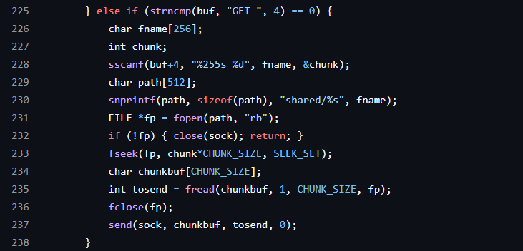
Handling GET command (sending a file chunk)

Slide 18
Cyber Security
USTH
SEARCHING FILES ON THE NETWORK
Network Programming
Group 2

Slide 19
Peers send SEARCH requests over TCP to all known peers.
Each peer responds with matching files’ metadata (name, size, chunks, hash, source).
Results from all peers are collected and displayed to the user.
Search enables finding files beyond local shared folder.

Slide 20
Sending SEARCH request
Receiving and processing search results (simplified):

Slide 21
Cyber Security
USTH
MULTI-THREADED
FILE DOWNLOAD
Network Programming
Group 2

Slide 22
Files are split into fixed-size chunks for efficient transfer.
Each chunk is downloaded concurrently by separate threads from available peers.
Download progress is tracked and displayed dynamically.
After all chunks are downloaded, they are merged and verified via SHA256 hash.

Slide 23

Creating download thread
Chunk download (thread function) processing search results (simplified):

Slide 24
Cyber Security
USTH
COMMAND-LINE
INTERFACE (CLI)
Network Programming
Group 2

Slide 25
Provides a simple text-based interface for user interaction.
Supports main commands:
share <filename> — share a local file by copying to shared folder.
list — list all locally shared files with info.
search <keyword> — search files across the network.
download <file_id> — download file by ID from search results.
Commands are processed in a loop until user exits.

Slide 26
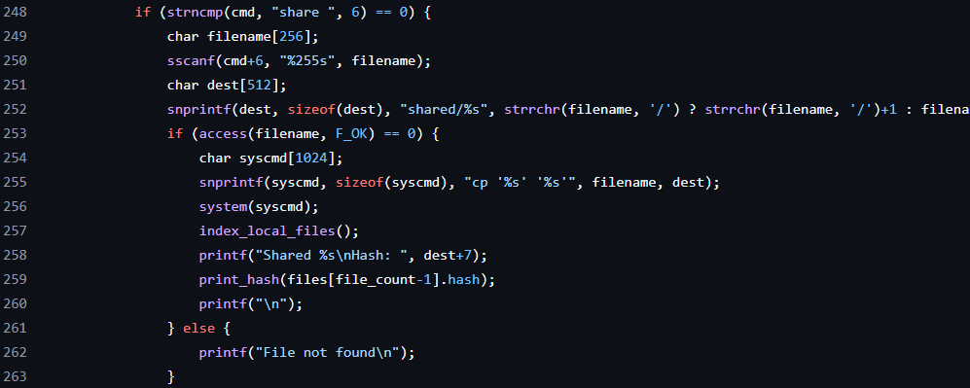
Handling the share command

Slide 27
Cyber Security
USTH
CONCLUSION
Network Programming
Group 2

Slide 28
This project successfully implements a decentralized P2P file sharing system with automatic peer discovery, multi-threaded downloads, and file integrity verification using SHA256. It provides a simple command-line interface for sharing, searching, and downloading files across peers. While effective, the system has room for improvement in peer management, error handling, and user interface. Future work can enhance scalability, security, and usability.

Slide 29
Cyber Security
USTH
THANK YOU FOR LISTENING
Network Programming
Group 2

